Slide 1
Healthcare Reform Impact on Providers
Lincoln Chamber of Commerce
September 19, 2013

Slide 2
The Big Question
Is now a good time to cut out of here for an hour?
Healthcare is a significant enterprise in Lincoln and Nebraska
Healthcare provides good jobs for the community
Affects supply of quality providers
Affects your recruiting
Affects the health of your workforce

Slide 4
5
Notes:
Here are the different subsidiaries (or affiliates) of the Health System.
You can comment on each or only some as you feel comfortable.
Describe the services they provide and the location if appropriate.

Slide 5
Mission and Vision
Mission
Bryan Health’s mission is to advance the health of individuals in our region through collaboration with physicians and communities.
Vision 2015 To be the partner of choice as the leading regional health system, through integration, collaboration and the relentless pursuit of excellence.
4

Slide 6
Medical Center Facts
Largest hospital in Lincoln with approximately 534 physicians, 3,250 employees and 600 volunteers and 56% inpatient market share.
Serves the Lincoln market and over 50 cities and towns in Nebraska, Kansas, Missouri and Iowa.
Largest private employer in the capital city of Lincoln.
Nationally recognized for services and outcomes in many specialties including orthopedic, cardiac and neurosurgical services.
8

Slide 7
Bryan Health: Did you know?
$506 million revenues and 3,700 employees
$40+ million in charity care (cost = $14 million)
$56 million unreimbursed costs from government programs
71,000 emergency room visits
47% of inpatient revenue comes from outside Lancaster county
Sponsor of 39-hospital Heartland Health Alliance

Slide 8
What’s the State of Healthcare Providers?
“Not-for-Profit hospitals saw declines in volumes, revenue growth” – Moody’s Investor Service
“2012 May have been the ‘high water mark’ year for hospitals” – Fitch
“Moody’s predicts slow revenue growth, confirms negative outlook” – Advisory Board Daily Briefing
“In states that say not to Medicaid, hospitals worry of “death by 1,000 cuts” – Advisory Board

Slide 9
ACA Gives 32 Million Coverage
Commercial
45%
Medicaid
18%
Uninsured
12%
Medicare
25%
Commercial
36%
Medicaid
24%
Exchange
9%
Uninsured
6%
Medicare
25%
Source: SSB Solutions

Slide 10
The Changing Business model
Fee For Service
Fee For Value
Population Health Management

Slide 11
U.S. Lives Buying Value by Funding Source
Source: Oliver Wyman

Slide 12
What’s the State of Healthcare Providers?
“In the exchanges, many plans will limit hospital choices.”
“Houston, we have a problem: Most young Americans haven’t heard of the exchanges.”
“Hospitals: We want an ACA delay too.”
“Doctors may see pay delay in ACA exchanges.”
Source: Advisory Board Daily Briefing

Slide 13
What’s the State of Healthcare Providers? Strong, vulnerable, fragile, scared
Declining volumes and declining reimbursement
No clear business model
Inconsistent quality results being published
Run to safety through mergers and alliances

Slide 14
Are We Ready for Health Care Reform?
Living it for three years
Reimbursement cuts
Value-based reimbursement
Reimbursement penalties
Transparency
New IT requirements
Profits at highest levels
FTE cuts
Supply negotiations
Benefit plan changes
Lean processes

Slide 15
What About Exchanges? 5 Things You Haven’t Heard
“I can’t wait for the Exchanges – I’ll finally be able to get insurance!”
“This Obamacare is really causing me to make lifestyle changes!”
“Looks like my premiums will really be going down!”
“I’m confident the government won’t increase my penalty.”
1. “It all seems so simple!”

Slide 16
Optimist
Exchanges bring consumerism
Challenge for consumer: Poor data
Challenge for providers: High deductibles = charity and bad debt
Medical Homes work
Population health management IT systems are almost ready for prime time
Providers working together with similar incentives

Slide 17
Participant Structure
Bryan Health Connect
Physician Hospital Organization
Bryan Health
Lincoln Independent Physicians
Heartland Health Alliance Members

Slide 18
Regional Provider Network
Bryan Health
Columbus Community Hospital
Faith Regional Health Services
Fremont Area Medical Center
Great Plains Regional Medical Center
Mary Lanning Healthcare
The Nebraska Medical Center
Nebraska Methodist Health System
Regional West Health Services

Slide 19
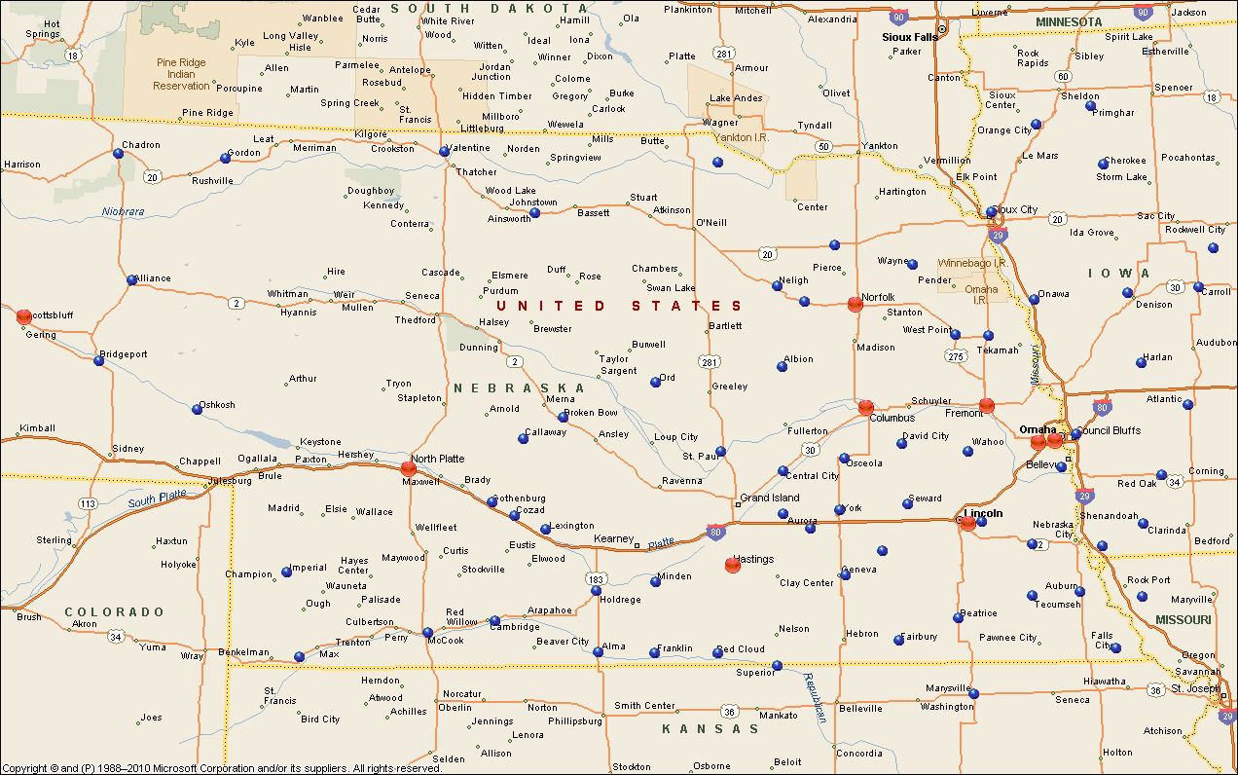
Regional Provider Network
Founding Health Systems
Critical Access Hospitals
Notes:
The red dots on this map indicate the nine founding health systems who initiated the discussions to form the Regional Provider Network. The blue dots represent critical access hospitals who have the opportunity to participate in the Network. Looking at this graphic, you can see the potential for a broad base of providers across the entire state of Nebraska as well as western Iowa, northwest Missouri and north Kansas.

Slide 20
Why Things Will Change
Networks are already forming
Employers seem committed
Exchange products are in place
Money-making volumes continue to decline
Rates continue to decline

Slide 21
Issues For Lincoln and Nebraska
Access
Physicians limiting government business; new entrants to fill gap?
Narrow networks
Critical but unprofitable services
Continuing High Quality
Attracting the best physicians and nurses
Capital for replacement and new technology
Implication: Philanthropy
Workforce health and recruiting

Slide 22
Three Other Implications
Medicaid expansion
Value of non-profit, tax-exempt providers
Community commitment

Slide 23
Mission and Vision
Mission
Bryan Health’s mission is to advance the health of individuals in our region through collaboration with physicians and communities.
Vision 2015 To be the partner of choice as the leading regional health system, through integration, collaboration and the relentless pursuit of excellence.
4

